Slide 1
Enhancing Usability, Explainability, and Trustworthiness of Data Systems Anna Fariha Ph.D, UMass Amherst
Notes:
Hi everyone. Thank you for giving me the opportunity to give this talk. Today, I am going to talk about my research on “Enhancing usability, explainability, and trustworthiness of Data Systems”.

Slide 2



What motivates my research?
Challenges in data systems that users face
Notes:
Let’s first talk a little about what drives my research in general:
My research revolves around addressing challenges in the use of data systems. These challenges can come from various aspects of the systems’ operation:
$some challenges are in the system interface;
$Some challenges are in understanding and trusting the behavior of systems that learned from data.
$Finally, there are challenges in figuring out causes of unexpected behavior of data systems.

Slide 3
Research objectives
How can we expose
inner workings of
data-driven systems, and
explain their behavior?
How can we make data systems more accessible?
Explainability
Usability
Trustworthiness
What makes data systems trustworthy?
Notes:
Motivated by these challenges, the high-level goal of my research is to meet the users of data systems where they are. I want to bring the data systems closer to their users. Broadly, my research has been centered around these three sub-areas: usability, explainability, and trustworthiness. In my research, I try to answer different questions within these areas.
Such as, $ How can we make data systems more accessible for a diverse set of users?
$ How can we enable user’s to effectively debug data systems, especially when something goes wrong, through explanation frameworks.
$ And finally, even when a system is sufficiently user-friendly and provides good explainability, is it trustworthy?

Slide 4
Database Query by Example
[VLDB 2019]
[SIGMOD 2018] (demo)
[TODS] (under review)
Explaining Disconnect between
Data and Systems
[SIGMOD 2022]
Explainability
Summarization by Example
[EMNLP 2021] (workshop)
[VLDB 2020] (demo)
🏆 Best demonstration runner-up award
Explaining Causes of Intermittent
Data-System Failures
[SIGMOD 2020]
Usability
Trustworthiness
Data Discovery by Example
[CIDR 2022] (abstract)
[VLDB 2021] (demo)
Conformance Constraints:
Trusted Machine Learning
[SIGMOD 2021]
[SIGMOD 2020] (demo)
[SIGMOD 2021] (demo)
Automatic Program Repair
[PLDI 2022] (under review)
Benchmarking Fair Classification Approaches
[SIGMOD 2022]
Research Accomplishment
Notes:
Here’s quick summary of my research accomplishment so far within these three pillars. I have worked on a number of usability enhancing systems, in the paradigm of programming by example such as database querying, data summarization, and data discovery. It is a simple way for the users to express their intent not by writing complex scripts, programs, or any formal specification, rather just by giving a few examples of system input and output.
$ Next, I worked on trustworthy machine learning and fair classification.
$ Finally, I have worked on explaining causes of data system malfunction in two contexts: intermittent data system failure and malfunction of data-driven systems due to unexpected data issues.

Slide 5
Database Query by Example
[VLDB 2019]
[SIGMOD 2018] (demo)
[TODS] (under review)
Explaining Disconnect between
Data and Systems
[SIGMOD 2022]
Explainability
Summarization by Example
[EMNLP 2021] (workshop)
[VLDB 2020] (demo)
🏆 Best demonstration runner-up award
Explaining Causes of Intermittent
Data-System Failures
[SIGMOD 2020]
Usability
Trustworthiness
Data Discovery by Example
[CIDR 2022] (abstract)
[VLDB 2021] (demo)
Conformance Constraints:
Trusted Machine Learning
[SIGMOD 2021]
[SIGMOD 2020] (demo)
[SIGMOD 2021] (demo)
Automatic Program Repair
[PLDI 2022] (under review)
Benchmarking Fair Classification Approaches
[SIGMOD 2022]
Research Accomplishment
Notes:
However, in this talk, I will focus on two of my work in detail and will give a brief summary of others.
This talk is divided into three parts: $ in the first part, I will present my work that fall within the usability umbrella. I will talk about a query-by-example system, to query relational databases without writing a single line of SQL. I will also briefly touch upon my work on example-driven text document summarization.
$ In the second part, I will talk about how we can achieve trusted machine in a data-driven way, guided by the data constraints.
In the last part, I will talk about my research vision.

Slide 6
Part 1: Enhancing Usability of Data Systems
Usability
Notes:
So, let’s get started on enhancing data systems’ usability.

Slide 7





Are data systems accessible to non-experts?
65% of the structured data resides in relational DBMSs.
Notes:
Computational systems and data are now highly available. All sorts of people want to use these systems and access data. But the problem is, people who lack a sound technical expertise don’t have a simple way to access and use these complex systems.
For example, about 65% of the structured data resides in relational databases. But to access these data, SQL expertise is a must.

Slide 8
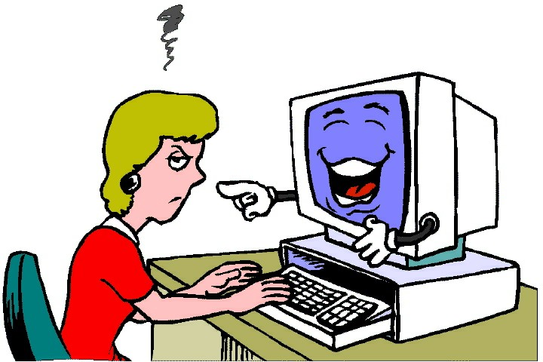
How to express complex task specifications?
Notes:
The second struggle, even for the experts, is to express complex task specifications that involve lots of parameters. Often, figuring out the right set of parameters is tedious.

Slide 9

Programming by example (PBE)
A step towards democratization of computational power.
Enhances usability for both non-experts and experts.
User
provides
examples
System
“guesses”
intent
Program
synthesis
Result
delivery
Notes:
Programming by example, PBE in short, is a successful paradigm for democratizing computational power for both non-experts and experts. In PBE, instead of writing programs, the user simply $ gives examples of what their desired output should look like. From the examples, the PBE system $ guesses the user intent, $ synthesizes a program, $ executes it to obtain results, and returns to the user both the synthesized program and the result. My work on enhancing usability is built on this PBE paradigm.

Slide 10

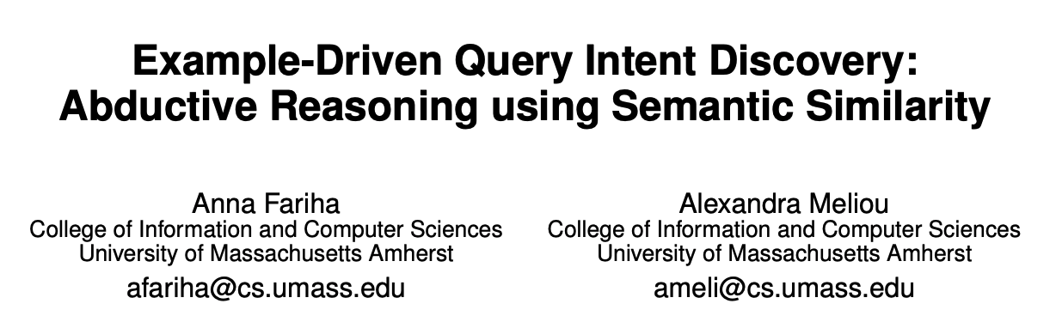
SQuID: querying relational DB by example
[VLDB 2019]
[SIGMOD 2018 Demo]
Notes:
I will start by talking about SQuID, which synthesizes SQL queries from user examples.

Slide 11
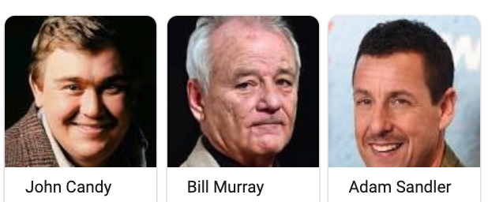

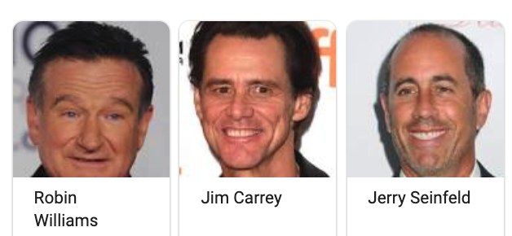
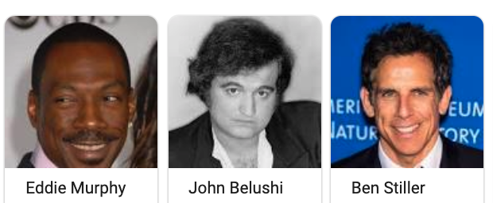
Find all funny actors from the IMDb database.
Notes:
Let’s first look at a motivating example over the IMDb database.
Suppose that a novice user has IMDb loaded in a relational database, and now they want to find all funny actors.
So let’s see the steps they will have to go through in a traditional setting.

Slide 12
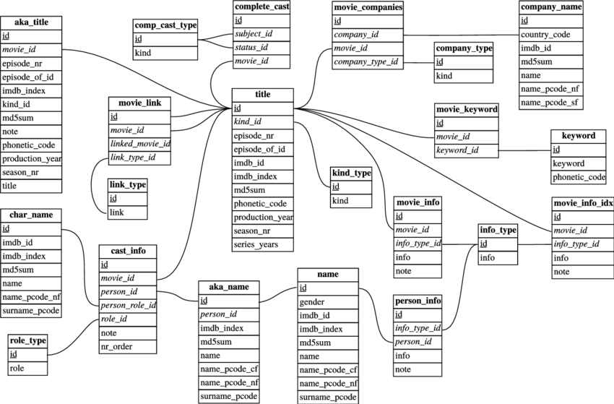

Challenge 1: understanding the schema
Notes:
The first step is understanding the schema and this is what the IMDb schema looks like.
$ Getting a good understanding of the schema is very challenging for novices.

Slide 13
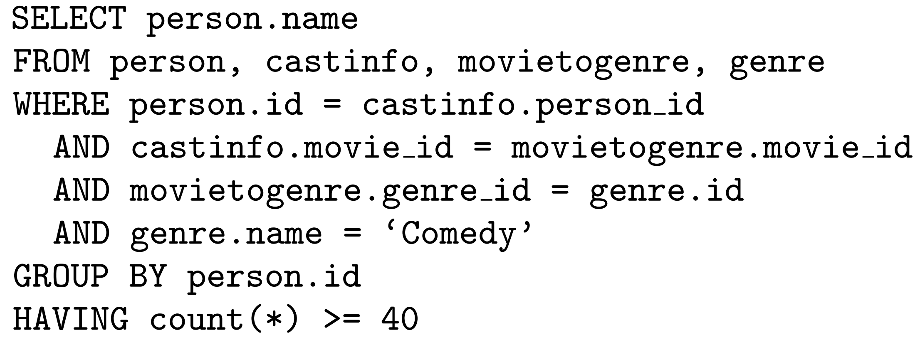
Challenge 2: SQL expertise
Notes:
Next, the user must learn a query language, like SQL, and write a query to express their intent. This is what the query might look like.
$ Again, this is very challenging for people without programming background.
What novices really need, is a way to easily express what they want, and the system takes care of these complex technical aspects.

Slide 14
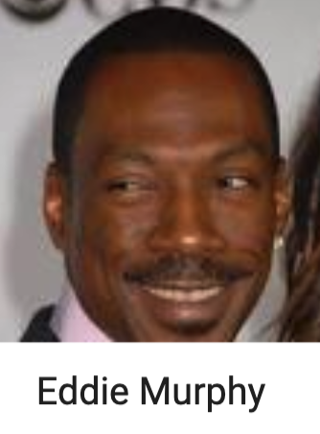
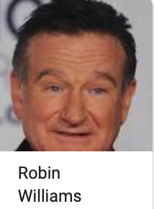
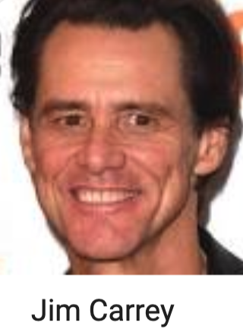
Query by example (QBE) can bypass SQL
QBE
Examples
Results
Notes:
Query by Example, QBE in short, is an instance of PBE, which can bypass the complexity of manually writing SQL queries.
All you need to do is $ just give a few examples. So, for funny actors, we can give Eddie Murphy, Robin Williams, and Jim Carrey, as examples, $ and give it to the QBE system. Then an ideal QBE system is $ supposed to figure out the query intent; and return all the funny actors.

Slide 15
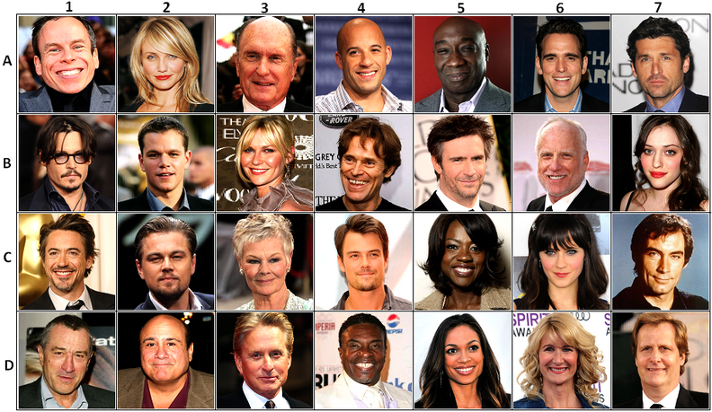
Traditional QBE systems fail
Examples
All actors
Notes:
But this is not what happens with traditional QBE systems. If we give these example funny actors to a traditional QBE system, $ this is what we get. A list of all actors in the data. The reason is that these systems only look at the type of the example values and detect intent that is too general.
As human, we see something more in the examples.

Slide 16
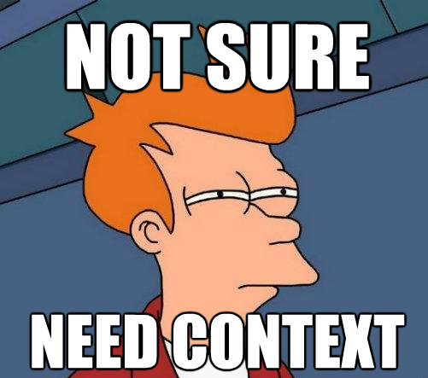
Humans use context
Notes:
We see context, what is similar across the examples, beyond the fact that they are all actors.

Slide 17



Discovering semantic similarity
Comedy
Comedy
Comedy
Comedy
Comedy
Comedy
There is no “funny” attribute in the data
Comedy
Comedy
Comedy
Comedy
Comedy
Comedy
Comedy
Comedy
Comedy
Comedy
Comedy
Comedy
Notes:
So how can we help QBE system detect the context? Unfortunately, there is no attribute in the data that explicitly says if a person is funny or not. But this information does exist in the data! If we take a closer look within the database and look at the types of movies these actors appear in, we will find this. Jim Carrey appeared in more than 40 Comedy movies, and so did Robin Williams and Eddie Murphy. This is a semantic similarity within the examples which captures the context of being funny.

Slide 18
SQuID Semantic-similarity-aware Query Intent Discovery
Modeling
Semantic Context
Query Intent Discovery
Evaluation
Notes:
SQuID’s key idea is to exploit semantic context to guess the user intent. SQuID is an acronym for semantic-similarity-aware query intent discovery. So, let’s see how SQuID models semantic context, how it discovers the user’s intent based on the semantic context, and how does it perform.

Slide 19
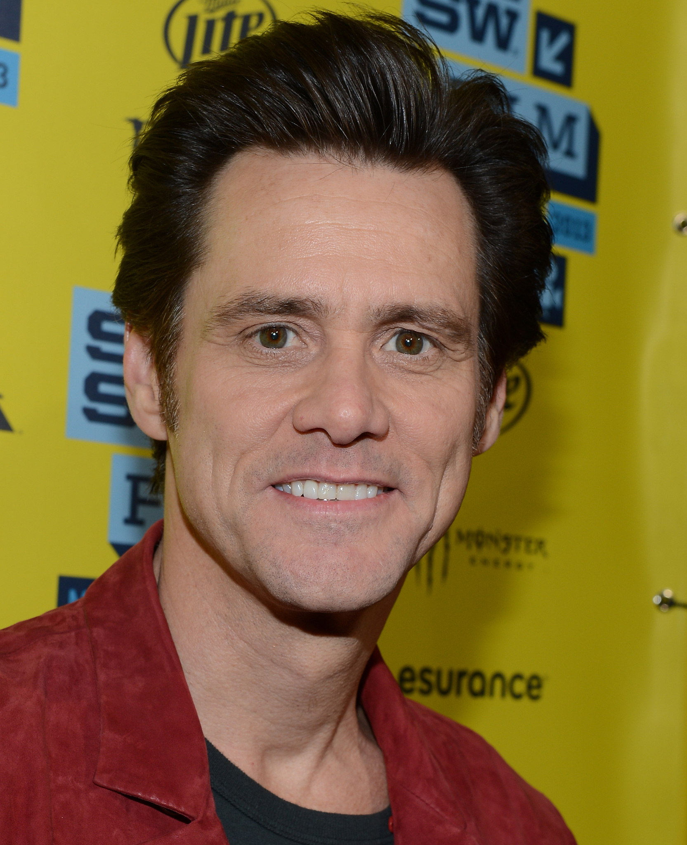
Semantic context: basic
Directly affiliated with an entity
birth year
1962
gender
Male
person
height
6’ 2’’
age
57
Notes:
Given a few examples, we can compute its semantic context by checking the common properties that are shared across all the example tuples. These shared properties model the semantic context of the example set. Semantic properties are properties that are directly or indirectly associated with an entity, like birth year or gender of an actor are their direct properties, and number of movies of a particular genre is an indirect property for an actor.
We categorize semantic context in two types. The basic semantic properties are directly associated with an entity, like birth year or gender of a person.

Slide 20
Semantic context: derived
Count of a basic property of an associated entity
number of comedy movies an actor appeared in
40 Comedy movies
genre
10 Drama movies
person
movie
language
67 English movies
COUNT (movies)
GROUP BY genre
Notes:
The derived semantic properties come from counting basic properties of affiliated entities, like the number movies of a particular genre is a derived property for an actor. For example, Jim Carrey appeared in 40 Comedies, 10 Dramas, and so on. You can compute this by $ grouping by genres and aggregate out movies.

Slide 21

Filters
Specify semantic context in SQL
SELECT
person
FROM
people
WHERE
color = orange
Notes:
To specify semantic contexts within SQL, we can use selection predicates, which I will simply call “filters”.

Slide 22
Intended or co-incidental?
Male
Born in North America
Appeared in 80+ Hollywood movies
Appeared in 40+ comedy movies
Appeared in 20+ drama movies
Height above 5 feet
Born after 1940
…
Notes:
So far, I highlighted that all these people are funny actors, and I inferred this context from the fact that they appear in mostly comedy movies. But these people are similar in other ways too. They are all male, they are all born in North America, and so on. Are all these similarities intended? How can we figure this out? Well, we can use data to figure out which of these properties are common in the data and would appear in any random examples anyway, vs which of these properties are rare. Intuitively, properties that are rare in the data, but are still observed in the examples, are most likely to be intended by the user.

Slide 23
Abduction
Most likely explanation of an observation
Most likely query, given the examples
Notes:
To infer the user intent from the examples, we use an inference mechanism called abduction. There are other well-known inference mechanisms like deduction and induction, which guarantee that the conclusion is correct based on the premises. But they do not apply for query intent discovery, because there is just no way to give a guarantee that what's in the user's mind.
Abduction is different in a sense that it derives the most likely explanation of an observation, but there is no guarantee. In query intent discovery, the observation is the examples, and their semantic context, and query is the explanation.

Slide 24
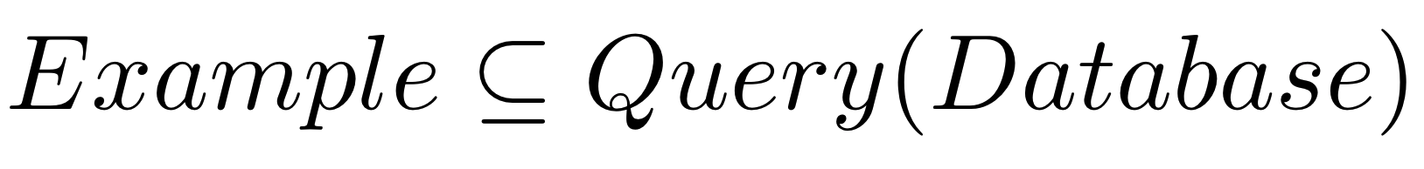
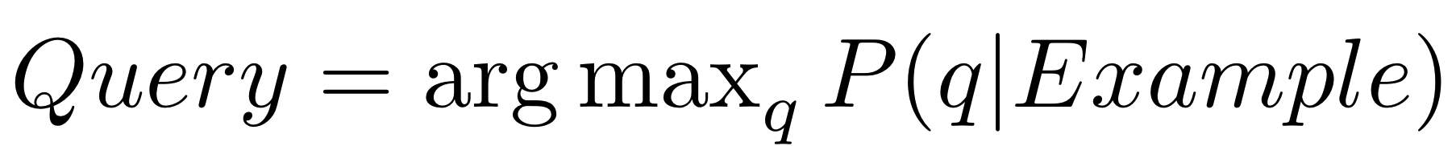
Problem definition
Query intent discovery: given a Database and Example, find a Query such that:
Notes:
So here is our problem definition: Given some examples, our goal is to find the query that satisfies two criteria.
One: the examples should be part of the query result, because the user definitely wants their examples in the final query result.
and
Two: the query should maximize the posterior probability of being the intended one, given the examples.

Slide 25
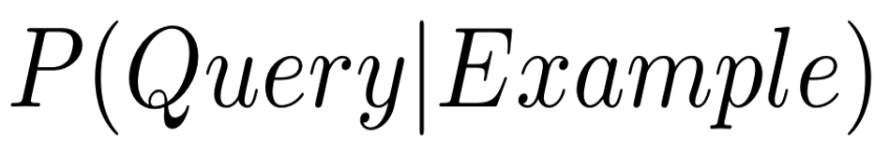
Probabilistic abduction model
semantic context posterior
query prior
query posterior
semantic context prior
Notes:
So we want to compute the Query posterior, the probability of a query being the intended one, given the examples, and this is our objective function, which we want to maximize.
$ Starting with Bayes formula, and since context is function of the examples, we can compute the query posterior using these three components…
$ query prior, which is the probability of that query being the intended one, without any observation.
$ semantic context prior, which estimates how likely it is to observe that context in a random example set.
$ and semantic context posterior, the probability that a semantic context is observed, after seeing the query.

Slide 26

Query prior
Filter with stricter constraint is more likely
SELECT * FROM p
WHERE 25 <= age <= 30
25 30
age
0 100
5 90
SELECT * FROM p
WHERE 5 <= age <= 90
Notes:
Now I will talk about how we estimate query prior.
A query is mostly about the set of filters it applies. If we can estimate the filter priors, we can combine them to estimate query prior.
To estimate filter prior, we exploit some intuitions. Our first intuition is $ that “stricter constraints are more likely”. For example, suppose that the data contains $ age in the range 0 to 100. Now $ this query is allowing a small portion from it, whereas $ this query at the bottom is allowing almost all of the data. So out of these two queries, the one on top is more specific than the bottom one. Our assumption is that a filter that puts stricter constraints $ is more likely.
There are two other intuitions involving derived semantic properties, I will skip those in this talk, but I am happy to talk about it later.

Slide 27
Context prior
database
Data selectivity
 | country
… | USA
… | USA
… | USA
… | USA
… | USA
… | CAN
… | USA
… | CAN
… | USA
… | USA
USA: 80%
CAN: 20%
Notes:
We move on to estimate the second term, semantic context prior. For this, the data can give us the answer. If we look at the data distribution inside the relations, we will see that USA is more frequent than Canada. So, prior to applying any filter, observing the context USA is more likely than observing Canada.

Slide 28
Context posterior
Context
Predicate in Query
database
examples
 | country
… | USA
… | USA
… | USA
… | USA
… | USA
… | CAN
… | USA
… | CAN
… | USA
… | USA
 | country
… | USA
… | USA
 | country
… | USA
 | country
… | USA
… | USA
… | USA
 | country
… | USA
… | USA
… | USA
P(USA | country = USA)
= 1
P(USA | No Filter)
= 0.8
P(USA | No Filter)
= 0.8 * 0.8
= 0.64
P(USA | No Filter)
= 0.8 * 0.8 * 0.8
= 0.51
Notes:
Now I will explain the last term of this equation: context posterior, which is the probability of observing a context, given the query. If we put the actual predicate in the query, then we know for sure that we will observe the context in the query output.
So now we want to figure out the probability that we will see the context, if we don’t put the predicate in the query.
Suppose that we see only one example with the context USA. So now the probability of observing the context, is just the proportion of the data that has this context.
What about now? With two examples, it is the product of the probabilities of observing the two examples individually, assuming independence. So, it will be 64%.
The key point here is, that the more examples we see confirming some context, the less likely it is that the context is just by chance. What it means is that the context is very likely to be intended and we should include it in the query.

Slide 29
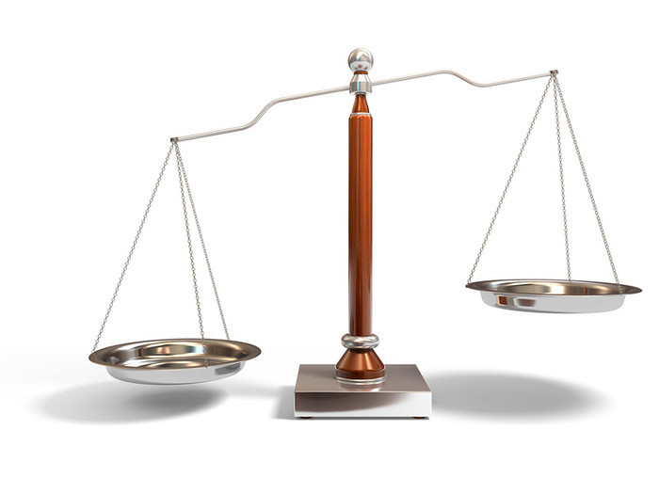
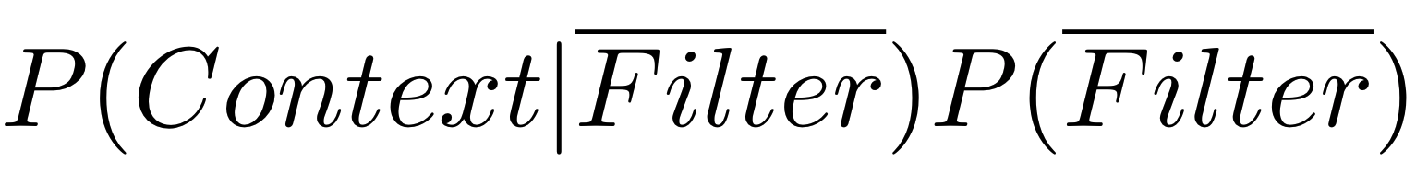
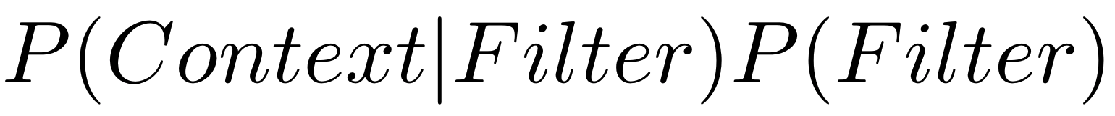
SQuID algorithm: to pick or drop filters?
Without filter
With filter
Notes:
In the paper, we have a detailed proof that a simple exact algorithm can find the most likely query intent, without trying all possible queries. The algorithm boils down to a simple principle. For each filter, if the quantity on the left is higher, then we pick the filter, and otherwise, we drop it. This is a simple, top-down, greedy algorithm which does not need to enumerate all possible queries and check their likelihood.

Slide 30
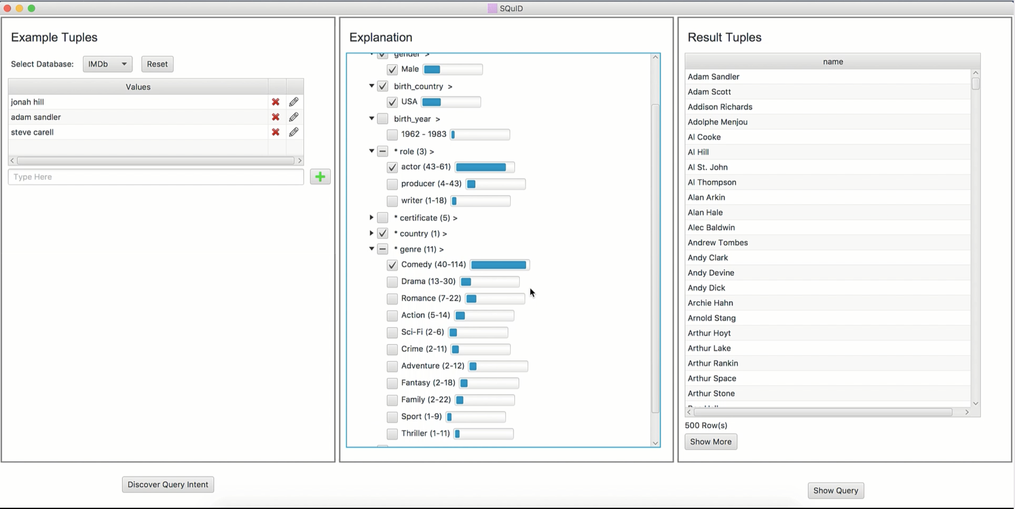
SQuID system

Slide 31


Slide 32

Experiment settings
Inferred Query
Result
Sample
SQuID Result
Example
Benchmark Query
Ground Truth
Compare
Notes:
We designed a few benchmark queries for this experiment. So let's see our experimental settings involving the benchmark queries. For this experiment,
we took a benchmark query,
executed it,
and considered the query result as the ground truth.
Then we took a small random sample from the ground truth and used that as example.
We gave it to SQuID.
SQuID returned an inferred query. We executed that query,
And found SQuID result.
Then we compared SQuID result against the ground truth in terms of precision, recall, and F-score.

Slide 33
Evaluation: how does SQuID perform with large datasets or many examples?
Inference time is practical
Logarithmic
in DB size
Linear in example size
Notes:
We varied the number of examples and tried IMDb datasets with three different sizes for the scalability experiment. We found that SQuID’s inference time is linear in number of examples, and logarithmic in database size. Also, the inference time is practical. For about 5 to 10 examples, it only takes a few seconds for IMDb.

Slide 34
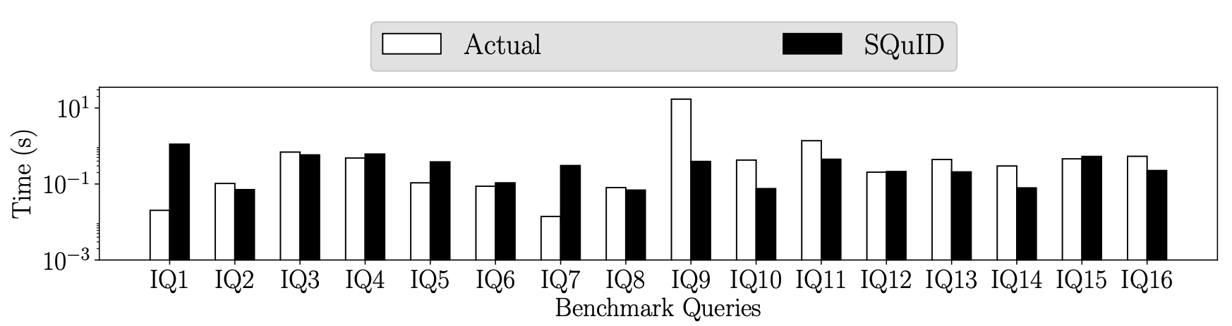
Evaluation: original query vs. SQuID query

Slide 35
Evaluation: does SQuID infer the right intent?
Find all Animation movies produced by Pixar
Notes:
We evaluated SQuID on three real-word dataset and over 40 benchmark queries. The first question we wanted to answer is, does SQuID infer the right intent? We tested SQuID on 16 benchmark queries over the IMDb database, but I am going to show you result for just one benchmark query as a representative. For this experiment, we used different subsets of the benchmark query output as examples, and then compared the precision, recall, and fscore of the output of the squid query vs the original benchmark query.
The query was to find all animation movies by pixar. As you can see, with very few examples, around 5 or 6, SQuID’s precision, recall, and F-score become very close to the optimal.

Slide 36
SQuID works with few examples
Notes:
Here is the overall result over 16 benchmark queries. In most cases, the F-Score rises quickly with very few examples.

Slide 37
Query reverse engineering (QRE)
Input
Output
QRE
TALOS
Reverse Engineered Query
Exact match required
Notes:
An approach like QBE is query reverse engineering. It also takes query results as input and produces query as output. But unlike QBE, it requires the examples to match exactly the query output. We compared SQuID with TALOS, a query reverse engineering system.

Slide 38
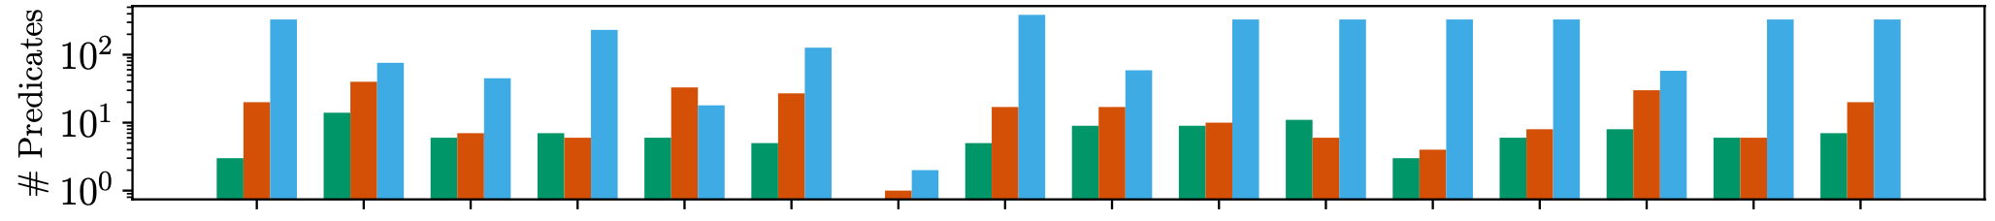

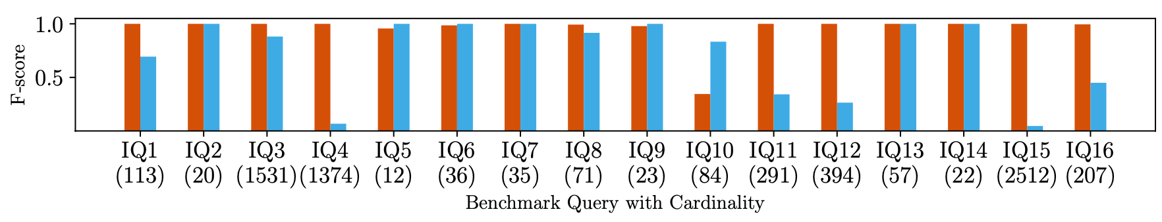
Evaluation: SQuID vs. QRE state-of-the-art TALOS
Query reverse engineering (QRE) requires entire query output
SQuID outperforms TALOS in speed and accuracy
Notes:
The second question is how does SQuID compare to other baselines. We empirically compared SQuID against a state-of-the-art query reverse engineering system called TALOS. Query reverse engineering has similarity with query by example, as it also takes query output as input, but it needs the entire output and just reverse engineers the query from its output.
So in our experiment, both SQuID and TALOS were given the entire output of the benchmark query. In general, $ SQuID is better than TALOS in terms of F-Score, and the inference is usually faster.
But what I want to focus on, $ is the quality of the inferred queries – how similar is the inferred query compared to the actual query.
For most of the queries, TALOS produced much larger queries than the actual ones with 100s of extra predicates. Note that, the y-axis is in log scale. Among all these benchmark queries…

Slide 39
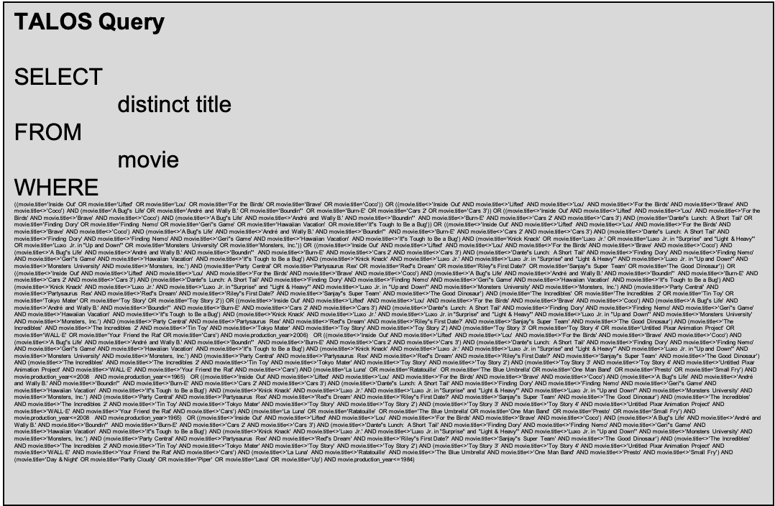
SQuID vs. query reverse engineering: query quality
SQuID Query
SELECT
DISTINCT movie.title
FROM
movie, production, company, movietogenre, genre
WHERE
movie.production_year >= 1984 AND
movie.production_year <= 2021 AND movie.country = USA AND
genre.name = 'Animation' AND company.name = 'Pixar' AND
movie.id = movietogenre.movie_id AND
genre.id = movietogenre.genre_id AND
movie.id = movietoproduction.movie_id AND
company.id = movietoproduction.company_id
Original Query
SELECT
DISTINCT movie.title
FROM
movie, production, company, movietogenre, genre
WHERE
movie.id = production.movie_id AND
production.company_id = company.id AND
company.name LIKE '%Pixar%' AND
movie.id = movietogenre.movie_id AND
movietogenre.genre_id = genre.id AND
genre.name = 'Animation';
QRE overfits
Animation movies produced by Pixar
Notes:
let’s look at this one. Again, the task was to find all Animation movies by Pixar.
This was the original query,
This is what SQuID inferred, with a few more predicates than the original. This is because it couldn’t figure out that some similarities were just co-incidental, and not intended.
But this is what TALOS produced!
Query reverse engineering approaches basically $ OVERFITS to the output and may fail to generalize the intent.
I have more results on SQuID, an interesting one is comparing against machine learning based approach and another one is scalability experiments, where we find SQuID logarithmically scalable with respect to the database size. I also have results of a couple comparative user studies. I will skip them in this talk, but I can talk about it more if anyone is interested.

Slide 40
SQuID outperforms machine learning
PU learning does not scale
PU learning requires >= 70% data as example
Generic machine learning cannot model RDBMS-specific assumptions
Notes:
Query intent discovery can be seen as a binary classification problem as well. The query is a classifier that classifies the tuples as intended or not. We compared SQuID with Positive and unlabeled learning, PU learning in short.
We found that PU learning needs way too many examples: it requires about 70% of the result as examples to match SQuID’s accuracy. Also, PU learning does not scale with database size.

Slide 41



Comparative user studies: SQuID vs SQL
SQuID
SQL
Notes:
So now let’s talk about how real users perceive SQuID. We conducted a comparative user study over 35 people where they were asked to solve the same set of data retrieval tasks using both SQuID and SQL.

Slide 42
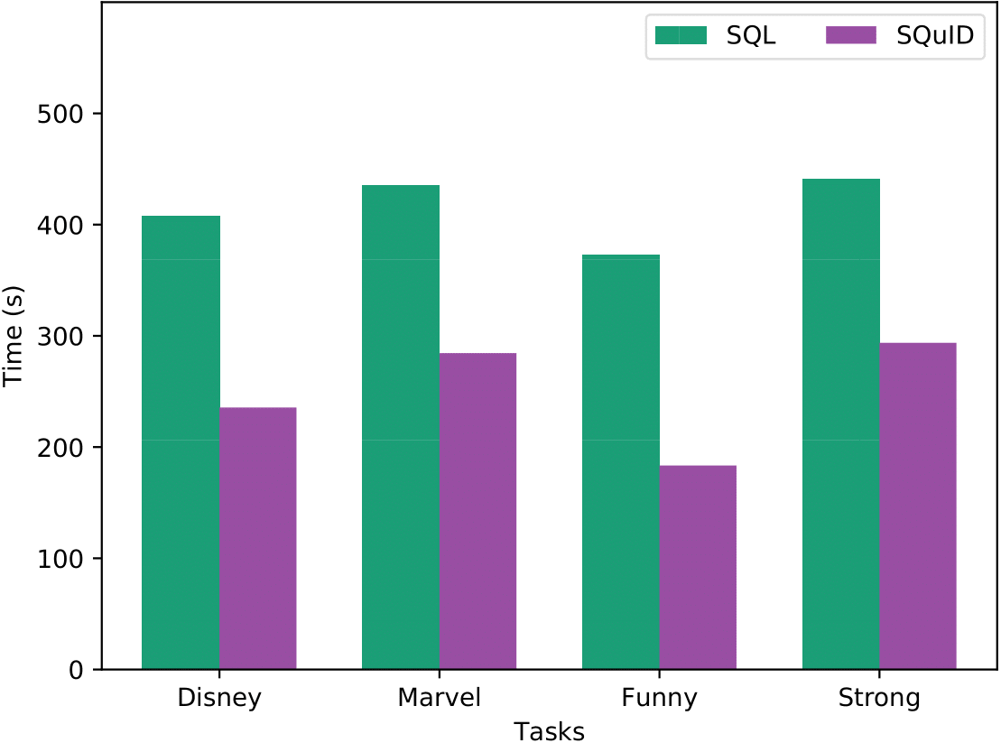
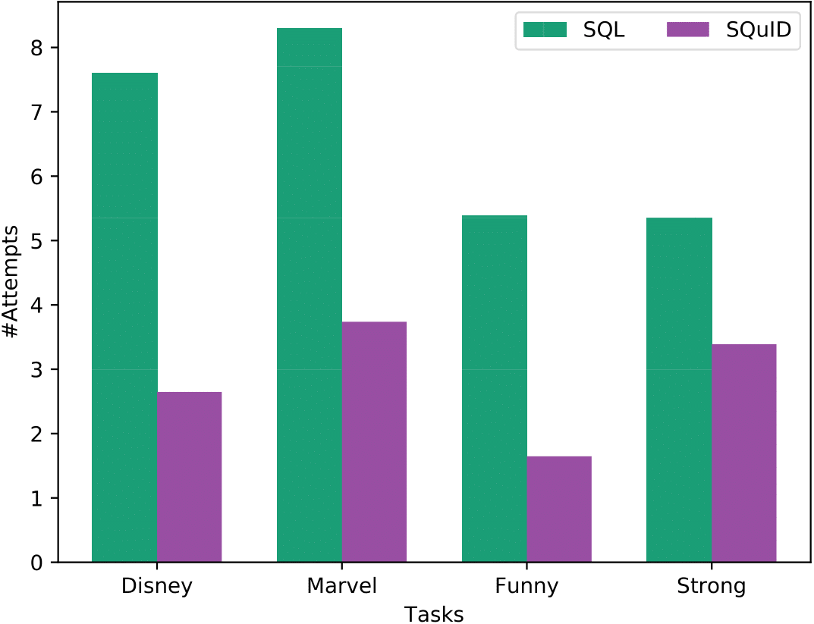
SQuID increased user efficiency
Notes:
In our study, we found the users to be significantly efficient while using SQuID than SQL, both in terms of time and number of attempts required to solve the task.

Slide 43
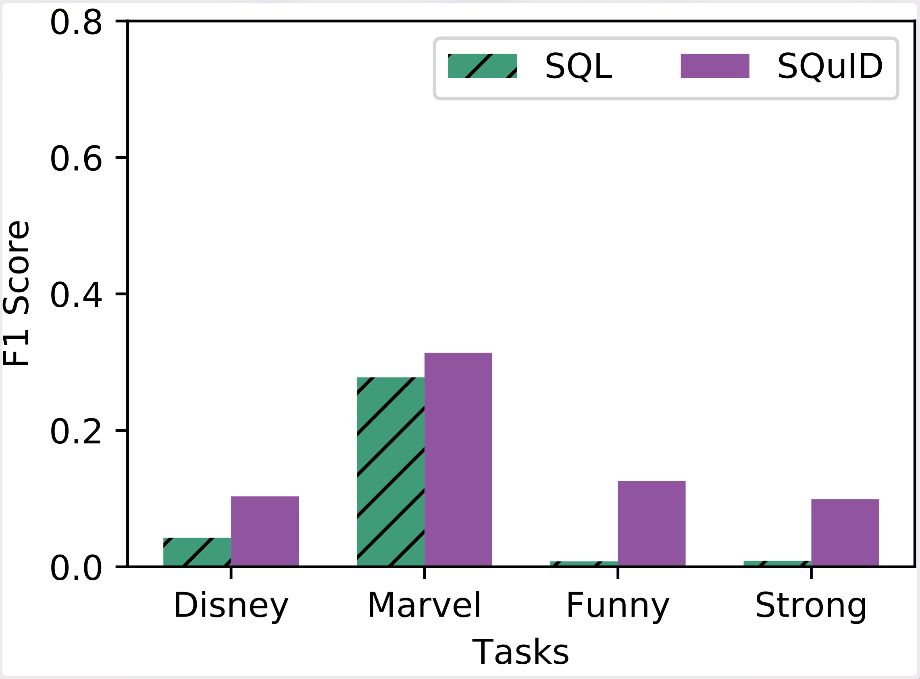
Overall, SQuID generated more accurate results
Notes:
We also found that overall, SQuID generated more accurate results in terms of F1-score, because the users could rarely write the perfect SQL queries with correct parameters.

Slide 44
SQuID was easier to use​
Notes:
Most of them found SQuID to be fairly easy to use.

Slide 45
SQuID or SQL?
Notes:
Interestingly, we observed that even though the users did better with SQuID and reported positively about it, they still tend to trust SQL more. Our guess is that this is due to lack of user control over SQuID’s inner mechanism and perhaps also because we did not expose SQuID’s explainability features during the study.

Slide 46


Anecdotal comments
“Even if I forget about syntax . . . figuring out how to go about writing the pseudocode query for funny actors [is difficult]”
“Vague tasks are generally a lot more open to interpretation. Coding up a query that meets someone’s vague specifications [is] hard . . . It was very hard to nail down what the correct definition of funny is.”
Notes:
We found anecdotal comments that sometimes it is not just about SQL: even if the users could write programs in their favorite language, some intents are inherently hard to specify in precise formal specification. This makes SQuID a really good alternative to SQL when the user intent is subjective or vague, even for expert users, for example, in the setting of data exploration.

Slide 47
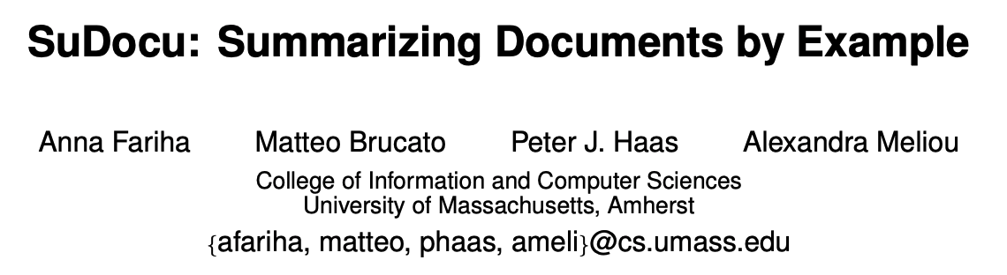
Personalized text document summarization
[VLDB 2020 Demo]
Best Demonstration Runner-Up @VLDB 2020
Notes:
While we designed SQuID over relational systems, I am interested in investigating by-example approaches in broader settings. An example of that is my recent work on SuDocu, which is a system that produces personalized summaries of documents, given a few examples summaries.

Slide 48



Document summarization by example
Example Summaries
Automatic Summaries
Notes:
The idea is, we can ask the user to summarize a few text documents manually, and then, the system SuDocu can learn the user’s summarization intent from the example summaries. Then for new unseen documents, SuDocu can produce summaries automatically, according to the user’s preferences. Due to time limitations, I will skip details in this talk, but I am happy to answer questions about it.

Slide 49
Part 2:
Trust in Data-driven Systems
Trust
Notes:
Alright, I will now move on to the third part, which is trust in data-driven systems.

Slide 50
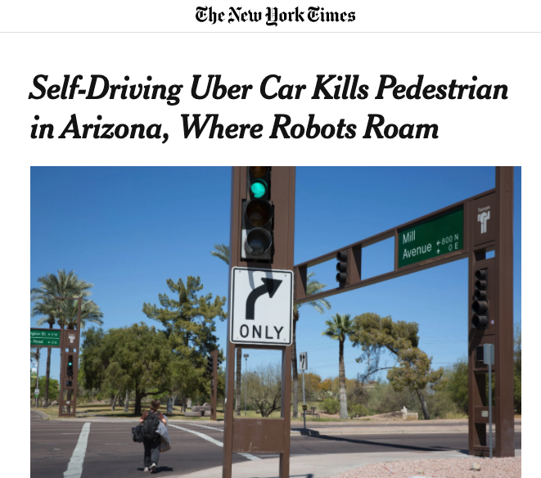
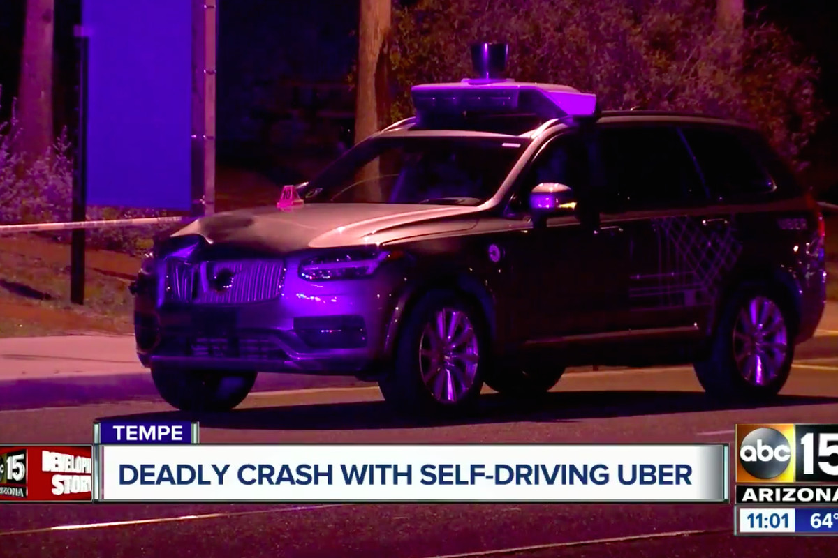
To trust or not to trust?
https://www.dailymail.co.uk/sciencetech/article-6001141/IBMs-Watson-suggested-inaccurate-unsafe-treatment-recommendations-cancer-patients.html
https://abc7news.com/technology/video-shows-deadly-crash-with-self-driving-uber-vehicle/3243857/
https://www.nytimes.com/2018/03/19/technology/uber-driverless-fatality.html
Notes:
We are now shifting towards data-driven prediction. But we need to be cautious about when we should trust these predictions. This becomes extremely critical when high-stake decisions are taken based on these predictions such as suggesting medical treatment or deploying self-driven cars.

Slide 51
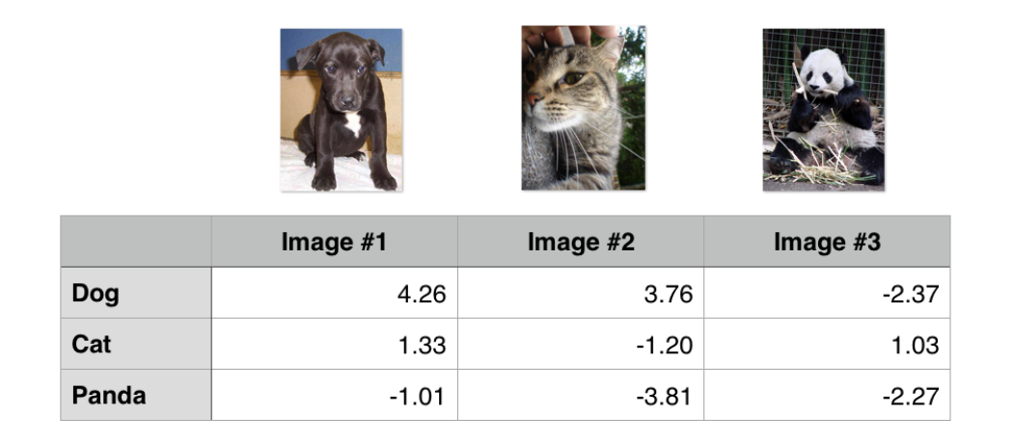
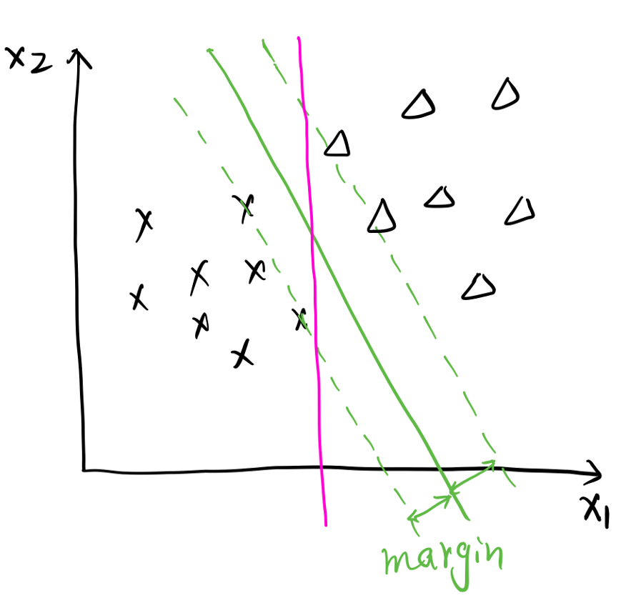
State of the art in trustworthy in machine learning
Look at prediction “probabilities”
Not well-calibrated, because those are not REAL probabilities!
Use distance from decision boundary
Doesn’t extend to regression
Notes:
Probability doesn’t mean twice as likely

Slide 52
ML models do not handle surprises well
Training data
New data (after deployment)
Red
Pink
Yellow
Orange
Green
Notes:
So let's take a look at a toy example. Suppose that you have trained your favorite machine learning model using these colorful apples to predict their color. Now you deploy your model and your model seems to work well for these new apples.

Slide 53

ML models do not handle surprises well
Training data
New data (after deployment)
Red
Pink
Yellow
Orange
Non-conforming
Green
Green
Notes:
But now, you encounter a strange watermelon wedge! Now the question is, would you trust your model’s prediction on this?
In data-driven learning, we sometimes encounter anomalous tuples, for which, the learned model is very much likely to make an incorrect prediction. This usually happens when the tuple is significantly different from what the model has seen during training. $ These are non-conforming tuples, that is, they don’t conform to the training data.
Our claim is that a tuple’s non-conformance is one of the key reasons of why prediction made on that tuple is likely to be untrustworthy.

Slide 54
Multiple answers!
X | Y | F(X, Y)
1 | 5 | 6
1 | 7 | 8
1 | 100 | 101
1 | -100 | -99
What is F(X, Y)?
Y + 1 ?
X + Y ?
We want to learn this!

Slide 55

As long as new data is conforming, we are good!
X | Y | F(X, Y)
1 | 5 | 6
1 | 7 | 8
1 | 100 | 101
1 | -100 | -99
1 | 500 | 501
What is F(X, Y)?
Y + 1 ?
X + Y ?

Slide 56


Oh wait! We are not good anymore ☹
X | Y | F(X, Y)
1 | 5 | 6
1 | 7 | 8
1 | 100 | 101
1 | -100 | -99
1 | 500 | 501
100 | 200 | 300
What is F(X, Y)?
Y + 1 ?
X + Y ?

Slide 57
Training data had an invariant or constraint
X | Y | F(X, Y)
1 | 5 | 6
1 | 7 | 8
1 | 100 | 101
1 | -100 | -99
1 | 500 | 501
100 | 200 | 300
Data Constraint: X = 1
Constraint violation may result in prediction error
ML models often perform dimensionality reduction or feature selection
and drops low-variance dimensions (X in this case)

Slide 58
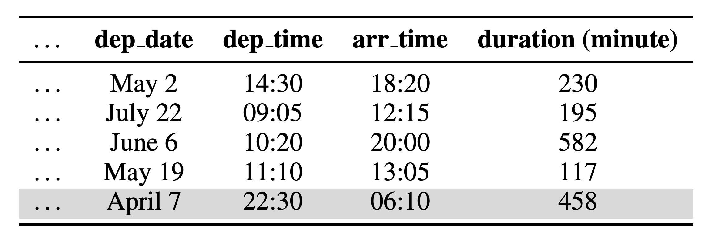
A real-world example: airlines dataset
Prediction task: predict arrival delay (regression)
DAYTIME
flights
OVERNIGHT flight
Notes:
Let’s take a look at a real-world example. Here you can see a sample of an airlines dataset. In this dataset, there are two types of flights: in daytime flights, arrival time is LATER than the departure time.
And for overnight flights, arrival time can be before than the departure time. The arrival date attribute is absent in this dataset. We trained a linear regression model to predict flight delays on the subset of this dataset with only daytime flights.

Slide 59
A real-world example: airlines dataset
Trained over DAYTIME flights
OK for other DAYTIME flights
FAIL for OVERNIGHT flights
Notes:
When we tested the learned model on other daytime flights, it seemed to perform well. But, for overnight flights, the model drastically failed. We found that there were a bunch of constraints that daytime flights satisfied.

Slide 60
Conformance constraints: flights
Departure (hour) | Arrival (hour) | Duration (min)
14:00 | 18:00 | 238
5:00 | 15:00 | 600
21:00 | 23:00 | 125
60 X Arrival - 60 X Departure ≈ Duration
Notes:
In fact, one of the constraint over the daytime flights was very simple: “60 times arrival minus 60 times departure should be very close to the flight duration”.

Slide 61
Conformance constraints: flights
Departure (hour) | Arrival (hour) | Duration (min)
14:00 | 18:00 | 238
5:00 | 15:00 | 600
21:00 | 23:00 | 125
21:00 | 1:00 | 240
Next day!
60 X Arrival - 60 X Departure ≈ Duration
Notes:
But for overnight flights, such as the one in the last row, the arrival time is on the $next day, which results in violation of the constraint over the daytime flights.

Slide 62
Constraint violation correlates with prediction error
Notes:
This indicates that constraint violation is strongly correlated with regression error, which results in untrustworthy prediction.

Slide 63
Conformance constraints:
a new data profiling primitive
constraints that the data satisfies
capture the invariants of the data
Notes:
To measure when we should trust predictions made by ML models that learned from data, we propose a new data profiling primitive called Conformance Constraints.

Slide 64
Conformance constraints
Encode linear arithmetic relationship over multiple attributes
-𝝐 $≤$(60 X Arrival) – (60 X Departure) – Duration $≤$𝝐
Projection
Lower bound
Upper bound
Notes:
This is the general form of conformance constraints, which encodes linear arithmetic relationship over multiple numerical attributes. In other words, we take data’s projection onto certain space and put bounds around that projected attribute to construct conformance constraints.

Slide 65
Conformance constraints
Encode linear arithmetic relationship over multiple attributes
-𝝐 $≤$(60 X Arrival) – (60 X Departure) – Duration $≤$𝝐
Projection
Lower bound
Upper bound
Notes:
The main building block of a conformance constraint is projection, which tells us through which lens to look at the data. Once we have decided on a projection, we can easily construct the bounds from the data’s distribution on that specific projection.

Slide 66
How to find good projections?
Find low-variance projections
Select projections with small mutual correlations
Notes:
To construct effective conformance constraints, our goal is to find good projections. For this, we follow two principles, which I will describe next.

Slide 67
Low-variance projections
High variance
F2
Low variance
F3
F1
High variance
Notes:
First is to look for low-variance projections. For example, here the projection F3 has lower variance than the other two projections, and as you can see, it captures the trend in the data better.

Slide 68
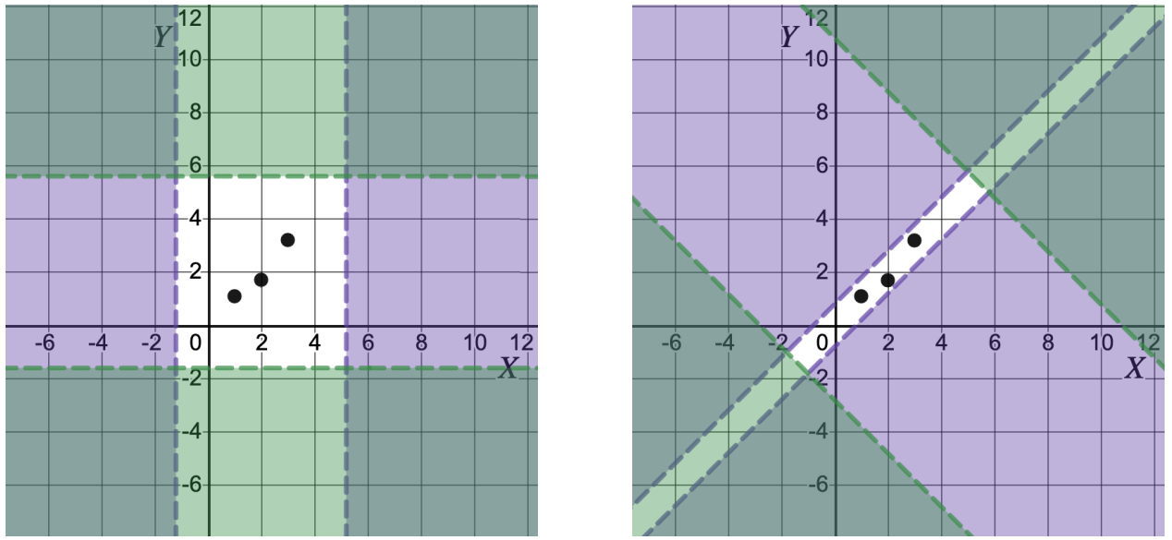


Projections with small mutual correlation
Notes:
The second principle is about selecting a group of projections. As we show in the paper, we should always pick projections with small mutual correlations for synthesizing effective conformance constraints.

Slide 69
Discovering projections:
Principal Component Analysis (PCA)
Low-variance principal components
Why? PCA returns several components including low-variance ones.
Small mutual correlations
Why? PCA generates orthogonal projections.
Notes:
These two principles perfectly align with the classical method of principal component analysis.
Traditionally, people use PCA for dimensionality reduction and discard low-variance components. But these low-variance components, which are kind of constant terms, can be used as constraints over the data, and that is our key idea.
Moreover, PCA produces projections with small mutual correlations as principal components are orthogonal to each other, which satisfies our second principle.

Slide 70
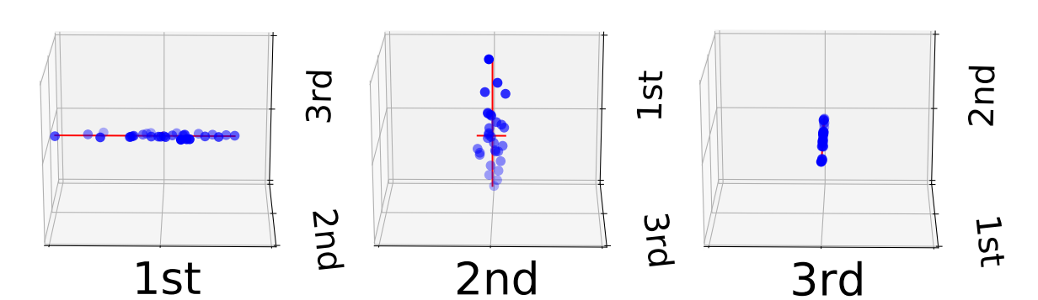
Computing tuple’s violation wrt constraints
Weigh low variance projections more
Weigh high variance projections less
Non-traditional use of PCA
weight

Slide 71
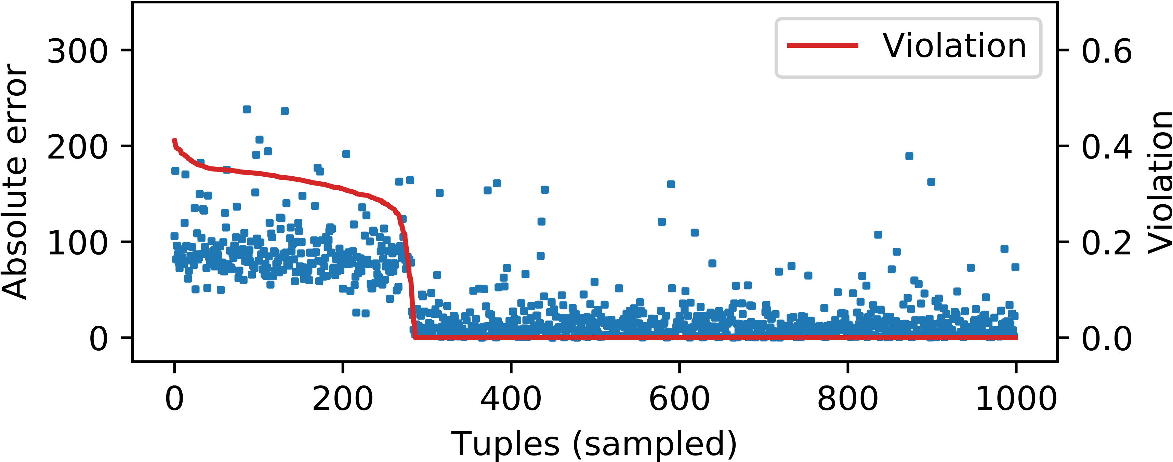
Evaluation: trusted machine learning
over the airlines dataset
Is there a relationship between conformance constraint violation and the ML model’s prediction error?
Notes:
Over the airlines dataset, we investigated if there is a relationship between conformance constraint violation and the decline in accuracy of predicting flight-delay. We observed that violation of conformance constraints, the red solid line here, has strong correlation with the regression error, shown by the blue dots.

Slide 72
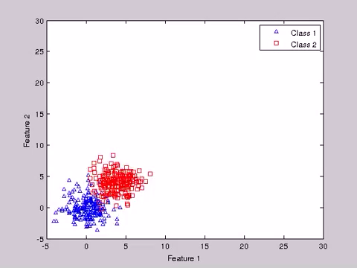
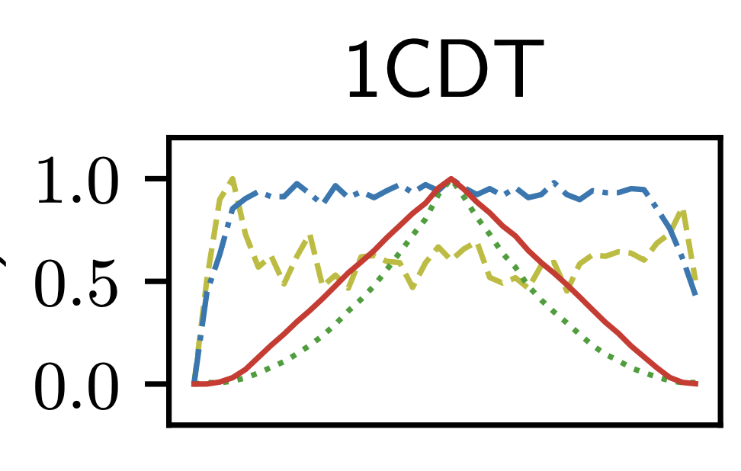
Evaluation: data drift over synthetic benchmark
Drift
Time
Notes:
The second application is quantifying data drift. This is over a synthetic benchmark, and we compared our approach against a few other baselines.
On the left, you can see, as time advances the data keeps drifting apart, and then comes back to the original distribution. On the right, you can see that conformance constraint violation, shown in the red line, quantifies the drift accurately, steadily increasing and then steadily decreasing, while the other approaches model lots of noise.

Slide 73
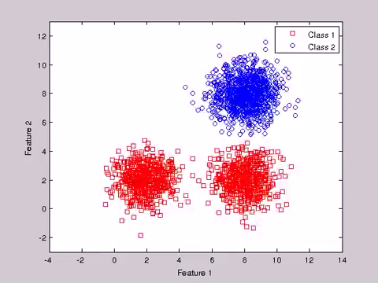
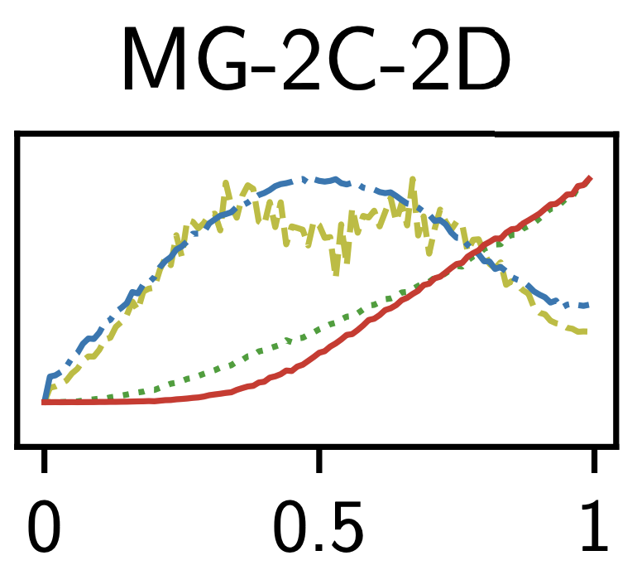
Evaluation: data drift over synthetic benchmark

Slide 74
ExTune: Explaining causes of tuple nonconformance
[SIGMOD Demo 2020]
Why is this different?
Notes:
I will now talk about another tool extune, built on top of conformance constraints, that help us understand causes for tuple nonconformance.
As we saw in the conformance constraint work, it can detect if a tuple is non-conforming, but it cannot really explain why it is the case? In what way, a non-conforming tuple is different than others? For this, we need an explanation framework.

Slide 75
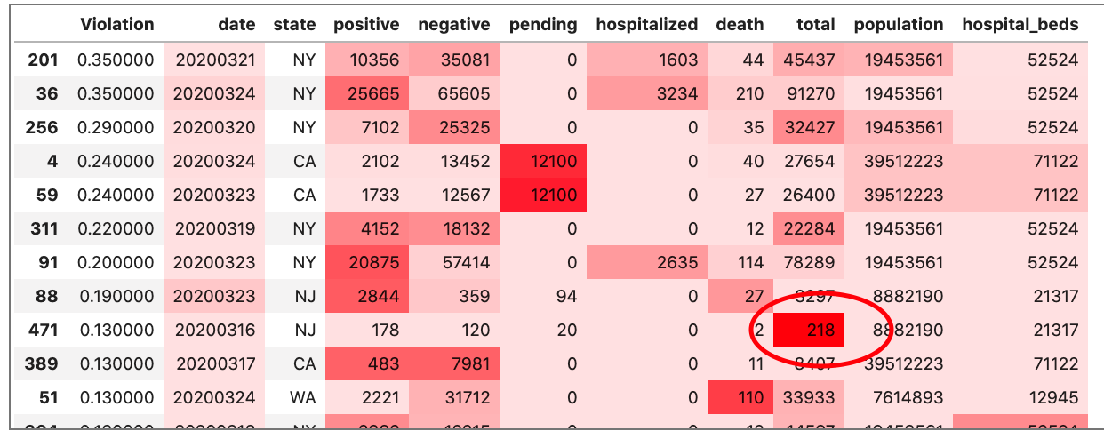
Explaining anomaly in COVID dataset
Constraint: #positive + #negative = #total
178 + 120 = 298
178 + 120 ≠ 218
Notes:
So, this is the ExTuNe interface, it draws a heatmap over the data cells. Darker shades mean more responsibility and lighter shades mean less responsibility. On the right, ExTuNe also shows aggregated attribute responsibility for causing non-conformance over the entire dataset. This result is for a cardiovascular disease dataset. ExTuNe correctly blames high blood pressure for causing heart disease, followed by weight, cholesterol, etc.

Slide 76

CoCo: Can constraints guide in data cleaning?
[SIGMOD 2021 Demo]
$$Arrival Time− Departure Time ≈Flight Duration$$
Departure Time | Arrival Time | Flight Duration | Distance Travelled | Arrival Delay
9:00 | 11:00 | 21 hours | 1000 miles | 0
Notes:
An obvious application of conformance constraints is data cleaning. The idea is to first learn constraints over a clean dataset and then consult those constraints for data cleaning. Violation of the constraints by a new tuple indicates that there is some error. For example, here, it is obvious that the flight duration should not be 21 hours, as it is inconsistent with the arrival and departure time.

Slide 77
CoCo: Can constraints guide in data cleaning?
[SIGMOD 2021 Demo]
$$Arrival Time− Departure Time ≈Flight Duration$$
Departure Time | Arrival Time | Flight Duration | Distance Travelled | Arrival Delay
9:00 | 11:00 | 2 hours | 1000 miles | 0
Notes:
Beyond just detecting data errors, the closed form expression of conformance constraints can suggest the correct values. For example, using the constraint here, CoCo suggests that the value for flight duration should be 2 hours.

Slide 78
Part 3: Research Vision
Notes:
Alright, I will now move on to to talk about my research vision.
35:00

Slide 79
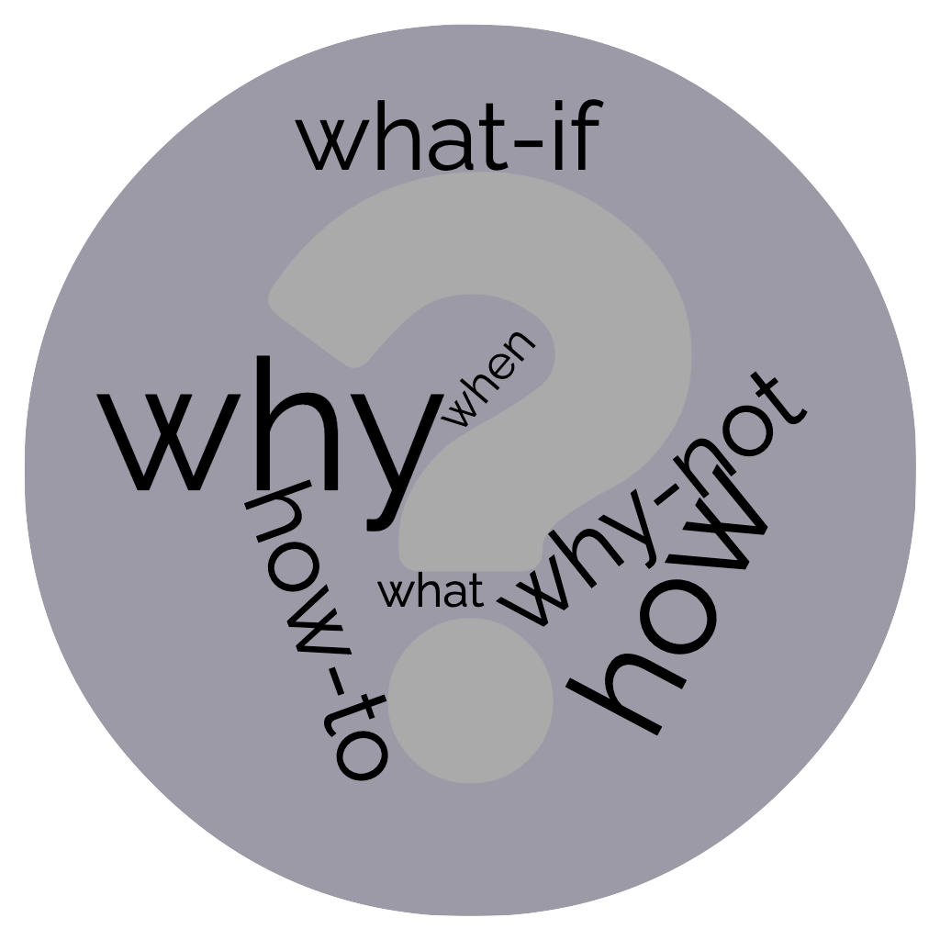



Research vision: bringing data systems closer to the users
HCI
Interface design, Visualization,
User-profiling…
Systems
Technology, Architecture, Algorithm…
Technology to empower users of data systems
Correctness
User-centeredness
debuggability, usability, explainability understandability, transparency, fairness, …
Performance
Notes:
Moving forward, I want to work on building tools and technology to enhance the notion of user-facing capabilities in data systems.
$ Research in designing and developing systems focus on many dimensions. This diagram here is by no means exhaustive, rather just a few examples of those criteria.
One is correctness, such as prediction accuracy of ML models or proper functioning of database management systems.
Another important dimension is runtime performance, we want systems to be efficient and scalable.
The focus of my research is on the dimension of user-centeredness, which demands a system to be easily accessible, debuggable, explainable, understandable, transparent, fair, and so on and so forth.
$ HCI is a leading area that focuses on some of these, but HCI research mostly focuses on understanding user needs, interface design, visualization and so on. But often, there is little to no support in terms of the underlying technology to support user needs.
$ On the other hand, systems research focuses on the technology, architecture, and algorithm to build effective and efficient systems, but often overlooks the user-centered aspects.
$ As a result, there is a gap between these two lines of research, and I want to bridge this gap by building technology that empowers the users of data systems. I see this as the missing piece of the puzzle.

Slide 80



Support for explanation in the design layer
Explainable machine learning:
provenance in ML and causal reasoning
Debuggability in information retrieval
Notes:
For instance, we are now building very smart AI, models with a billion parameters, but when things don’t go as expected, we can do very little to dig deeper. Because these systems are not transparent and lack explainability that users can relate to. A possible direction towards solving this issue could be provenance and causal reasoning. […]
As another example, we have excelled in data storage, retrieval, and management, but even today, if a user wants to know what’s wrong in their SQL query, the result doesn’t look right, there is no simple mechanism to answer these.
Specifically with respect to data-driven systems, I am interested in understanding and repairing bugs that relate to the impact that data has on the system. I am not simply talking about errors in the data, but, rather, cases where data may lead to system malfunction due to a disconnect between properties of the data and the system design. For example, when a system is designed to handle dates in the US format, but the data has date formatted in the European format, neither the data is wrong, nor is the system, but there is a mismatch between what the system expects from the data. The goal of this project is to identify such mismatches.

Slide 81
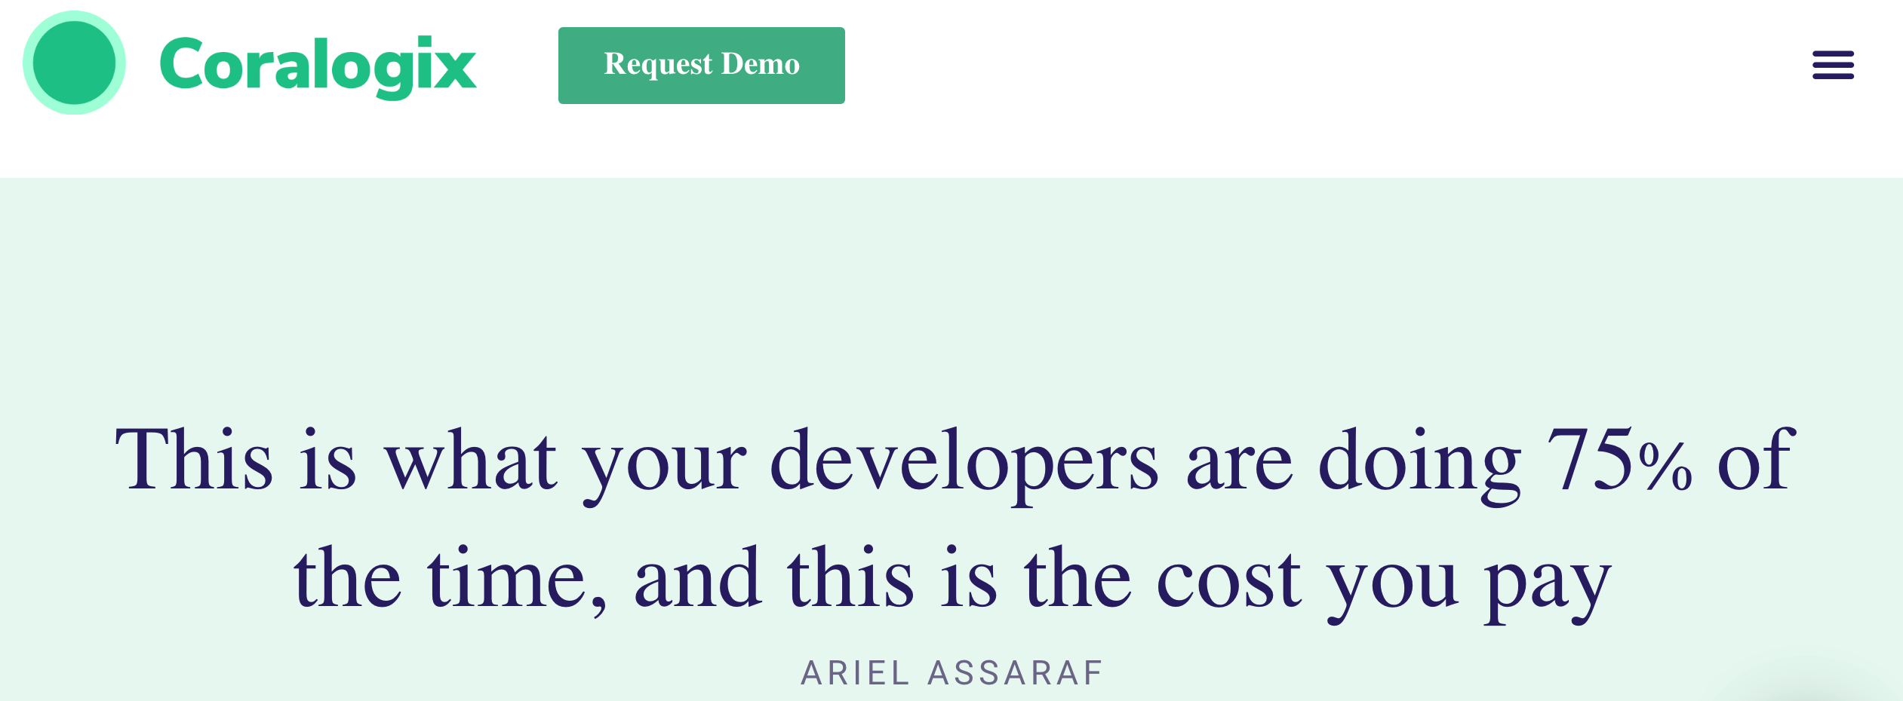
Developer productivity: automatic program repair
https://coralogix.com/log-analytics-blog/this-is-what-your-developers-are-doing-75-of-the-time-and-this-is-the-cost-you-pay/
Notes:
As my future work, I want to build tools to support debugging, in other words, automatic program repair. Some recent studies claim that about 75% of the developer time is spent on debugging! And this makes debugging challenges an industry-wide issue. Currently, there is a lot of ongoing effort for improving only the 25% of the tasks that developers do, that is coding. We have suggestions, help in refactoring and so on and so forth. But the big chunk, this 75%, this is where I think we should put much more focus.

Slide 82
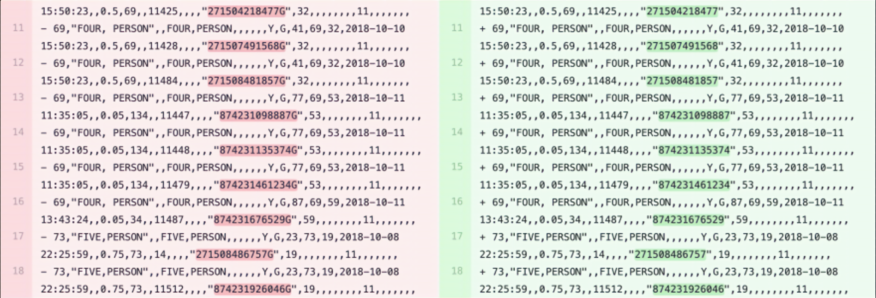
Data change summarization: data diff
Notes:
Within the theme of explanation, I am also interested in another problem. In version control systems, like git, when source code changes, we investigate it by doing a git diff. But when it comes to data, git diff is useless. The problem is motivated from the fact that understanding differences between two databases in the way we do git diffs, simply does not work, because most of the time, there are too many changes. So the question I am trying to answer is how we can describe differences between two databases of identical schema, semantically? For example, can I say males in your data changed this way and females changed in this other way?

Slide 83

Research vision: bringing data systems closer to the users
Notes:
In summary, I want to build technology to answer these why, what, what if, why not, and how to, questions. For that, my goal is to get inspired by the user asks from HCI research and build technology to support those user needs.

Slide 84







Acknowledgement
Emery Berger
Matteo Brucato
Lucy Cousins
Juliana Freire
Vijay Gadepally
Sainyam Galhotra
Sumit Gulwani
Peter Haas
Maliha Tashfia Islam
Eunice Jun
Raoni Lourenço
Narges Mahyar
Alexandra Meliou
Suman Nath
Anshul Negi
Vincent Pun
Arjun Radhakrishna
Elkindi Rezig
Divesh Srivastava
Michael Stonebraker
Ashish Tiwari
Allan Vanterpool
Notes:
Finally, this is a partial list of my fantastic collaborators who have been a great source of inspiration.

Slide 85
Database Query by Example
[VLDB 2019]
[SIGMOD 2018] (demo)
[TODS] (under review)
Explaining Disconnect between
Data and Systems
[SIGMOD 2022]
Explainability
Summarization by Example
[EMNLP 2021] (workshop)
[VLDB 2020] (demo)
🏆 Best demonstration runner-up award
Explaining Causes of Intermittent
Data-System Failures
[SIGMOD 2020]
Usability
Trustworthiness
Data Discovery by Example
[CIDR 2022] (abstract)
[VLDB 2021] (demo)
Conformance Constraints:
Trusted Machine Learning
[SIGMOD 2021]
[SIGMOD 2020] (demo)
[SIGMOD 2021] (demo)
Automatic Program Repair
[PLDI 2022] (under review)
Benchmarking Fair Classification Approaches
[SIGMOD 2022]
Notes:
That concludes my talk. Let me take this opportunity to thank you for letting me talk to you about my work on democratizing data systems. And I thank everyone for your attention. At this point, I would like to invite any questions.

